Slide 1
Group 1 and 2

Slide 2
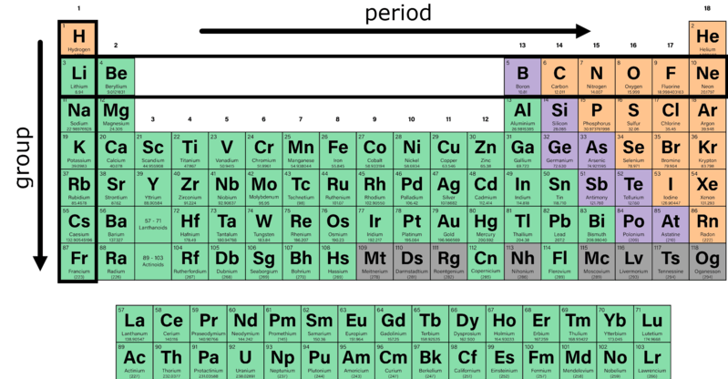
In the lesson on The Periodic Table, it was mentioned that each group shares similar characteristics.
The next few lessons will explain the similarities, differences and properties of groups 1 and 2.

Slide 3


Group 1 elements are known as the alkali metals.
All alkali metals are highly reactive and, due to having 1 valence electron, form ions with a charge of +1.
The alkali metals are lithium (Li), sodium (Na), potassium (K), rubidium (Rb), cesium/caesium (Cs) and francium (Fr, not covered in this lesson).
Reactivity increases as you move down the group. This is because the valence electrons are getting further from the nucleus, and are easier to remove.

Slide 4

Alkali metals will react to produce similar compounds.
For example:
They will all react with chlorine to form ionic compounds with the formula XCl, where X is an alkali metal.
They will all react with oxygen to form ionic compounds with the formula X2​O, where X is an alkali metal.

Slide 5
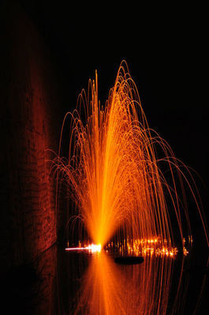
Alkali metals are very soft and you can cut most of them with a knife.
Alkali metals react violently with water. Any alkali metals stored in your school will probably be completely submerged in oil to avoid unwanted reactions.

Slide 6
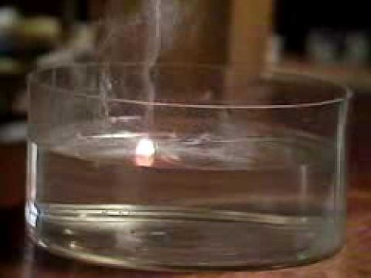
Watch this video (2:21) for an example of how reactive alkali metals are.

Slide 7

Group 2 elements are known as the alkaline earth metals.
All alkaline earth metals are reactive (though not as reactive as alkali metals), and, due to having 2 valence electrons, form ions with a charge of +2.
Reactivity increases as you move down the group. This is because the valence electrons are getting further from the nucleus, and are easier to remove.

Slide 8
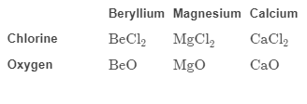
Alkaline earth metals react to produce similar compounds.
For example:
They will all react with chlorine to form ionic compounds with the formula XCl2​, where X is an alkaline earth metal.
They will all react with oxygen to form ionic compounds with the formula ,XO where X is an alkaline earth metal.

Slide 9
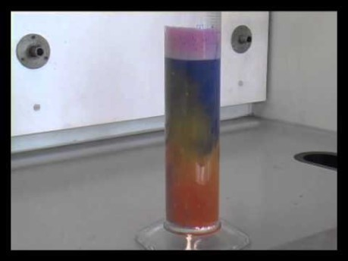
This video (2:09) demonstrates the reactivity of alkaline earth metals with water.

